Slide 1
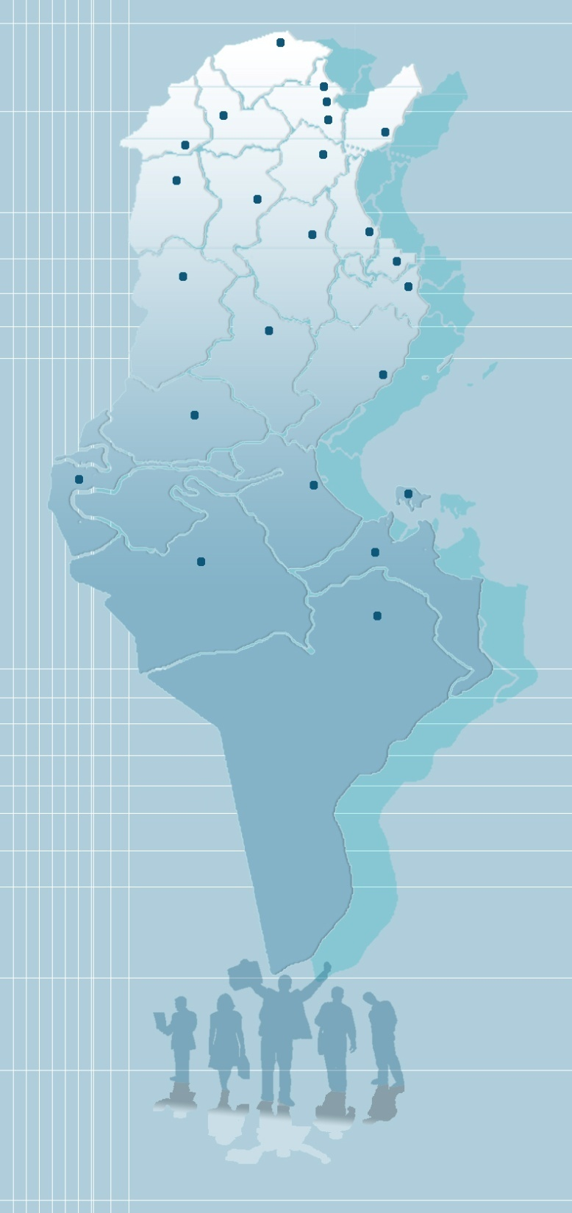
.
Ministry of Higher Education
and Scientific Research
The General Directorate
of Technological Studies

Slide 2
Presentation of The General Directorate of Technological Studies
The Higher Institutes of Technological Studies were created in 1992 while The General Directorate of Technological Studies was founded in 2001. It consists of the following three departments:
- Administration of Higher Institutes of Technological Studies - Administration of Engineering Studies - Administration of Partnership with The Environment and Professional Integration

Slide 3
Administration of Higher Institutes of Technological Studies
Sub-Directorate of training
Sub- Directorate of Planning and equipment
Sub-Directorate of technologists
Service of competitions to enter The Higher Institutes of Technological Studies
Technical studies and planning service
Technologists recruitment service
Service of Pedagogical Programs
Service of equipment, fixtures and maintenance
Service of Monitoring of technologists’ professional careers

Slide 4
Sub-Directorate for Technological Studies
Sub-Directorate of Training
Sub-Directorate of competitions to engineers training
Service of Pedagogical programs
Service of Financial Management
Service of Monitoring and Evaluation
Service of Registration

Slide 5
Administration of Partnership with The Environment and Professional integration
Sub-Directorate of professional integration
Sub-Directorate of the Partnership with the environment
Service of Incubators enterprises
Service of Continuous training
Service of projects development ad monitoring
Relationship with the environment

Slide 6
Administration of Higher Institutes of Technological Studies
The tasks being carried out are as follows:
Organizing purchases to supply Institutes with the necessary scientific equipment
Pedagogical supervision within the Higher Institutes of Technological Studies
organizing recruitment competitions related to the various technologists categories

Slide 9
Teachers Body in Higher Institutes
Their task is to ensure the most part of the trainig and to supervise internships and applied activities as well as to oversee applied research programs and continuous training.
Technologists
Contributing to the training sessions in different disciplines (Teachers, researchers, teachers of secondary education ...)
Other category teachers
30% of instruction hours are performed by experts and professionals
Professionals
The ratio of coaching in the Higher institutes of Technological Studies has been in the range of one professor for every 12 students

Slide 10
Distribution of Teachers within the network of Higher Institutes of Technological studies from february 2012
Number | Teachers category | Number | Teachers category
234 | Attachés of secondary education | 400 | Assistant Technologists
2 | University teacher | 1340 | Technologists
7 | Lecturer | 106 | Technologists as Lecturers
75 | Assistant professor | 3 | Associate Professor
21 | Assistant Teacher of higher education

Slide 11
Development and Distribution of the Framework of Teachers in 2012:
Distribution of Technologists
1340 Technologists
648 Assistant Technologist
106Lecturer
Technologists
88%
4%
8%
2236
2418
2454
2883
Researchers
secondary education teachers
Distribution of the Framework of Teachers in 2012
2009
2010
2011
2012

Slide 12
Data related to The Competition to recruit Technologists

Slide 13
L.M.D System within the Higher Institutes of Technological Studies
This system consists of two main areas:
Sciences And technologies of Information and communication
- Mechanical
Engineering
- Textile Engineering
Field of sciences and technology
1
Civil
Engineering
Technologies of information
Electrical
Engineering
Methods
Engineering

Slide 14
L.M.D System within The Higher Institutes of Technological Studies
2
Field of Economic Sciences and Management
Business management
Marketing
26 co-constructed Applied Licenses are being ensured in some institutes

Slide 15
Sub-Department of Planning and Equipment:
This department is concerned with the second part of the budget of the Ministry of Higher Education and Scientific Research aimed for Higher Institutes of Technological Studies. A - Equipment is divided into :
-Furniture - audio and visual media Equipment -Pedagogical and scientific equipment
B- Procedures: . collecting of Institutes needs. .Determining the annual budget for each Institute within the Ministry's budget. .Completing and sorting out of tenders and then assigning of transactions and follow-up ; suppliers payment and follow-up of equipment work during the warranty period and then file the final seal.

Slide 16
Source of Funding I External funding
1 - World Bank for Reconstruction and Development (5.2 billion) 2 - Islamic Development Bank (4 million U.S. dollars) 3 - The European Bank for Development (600 million special Bizerte) 4 - Organization of Petroleum Exporting Countries (about one billion) 5 - Kuwaiti Development Bank (processing Medenine Institute - Tataouine –one million and 250 thousand dinars). II - Financing the Public Treasury of Tunisia Acquisitions in the process of achievement (4.5 billion) Acquisitions programmed the remaining budget for 2011 and 2012: 14 billion

Slide 17
Administration of Engineering Studies
Its main tasks are :
-The pedagogical supervision and Rehabilitation of Engineering training institutions.
-organising the competitions to enter the engineering training stages

Slide 18
Access routes to The Engineering Trainig Institutions in Tunisia
Bachelor Degree
High-ranking technicians
training stage
Prparatory Cycle of Engineering Studies
Integrated Prparatory Cycle
(INSAT et ISSATSousse)
The specific exams by
files
The National Competition
by exams
Competition by files
Engineering Training Stage

Slide 19
27 schools are currently ensuring stages of engineering training classified according to the nature of training:
18 Enginneering schools comprising:
.7 Agricultural engineering schools .11 Non-Agricultural schools
.Faculty of Sciences Tunis
.7 Higher Institutes are eligible to host training for engineers
.National Institute of Applied Sciences and Technology
21 institutions provide preparatory stages including 2 providing integrated preparatory stages

Slide 20
Number of Students Enrolled in The Engineering Schools
For the Academic Year 2011-2012
Institution | Number of students |  |  | The total number
 | First year | Second year | Third year
The non-agricultural engineering institutions (12) | 4139 | 3532 | 3252 | 10923
The Agricultural engineering institutions (7) | 681 | 731 | 676 | 2088
Higher Institutes of Applied Sciences and Technology (7) (engineers training stage) | 647 | 609 | 419 | 1675
The National Institute of Applied Sciences and Technology | 674 | 837 | 326 | 1837
Overall data | 6141 | 5709 | 4673 | 16523

Slide 26
Year | 2011
Number of students admitted to th French School of Wood | 2012

Slide 27
Administration of Partnership with the Environment and Professional Integration :
The tasks are as follows: - Follow-up of incubators activity and management of the initiative programs for individual entreprise
- Follow the employability of different operational licenses and certificates of Engineers

Slide 31
Growth of provisions in the First Part
Growth of provisions for the Higher Institutes of Technological Studies
( in 1000DT)

